Slide 1

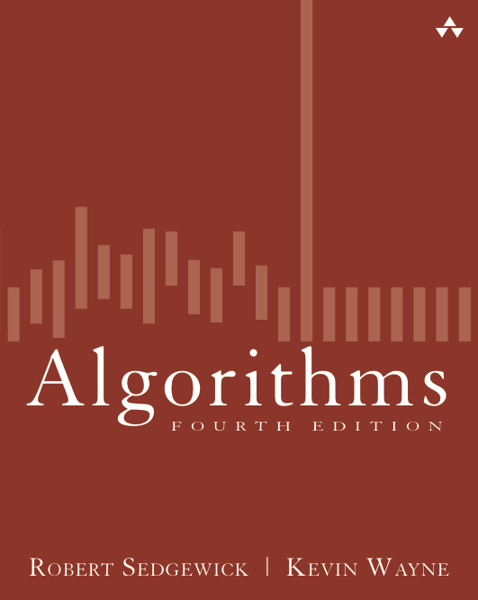
2.1 Selection Sort Demo
Algorithms
Robert Sedgewick | Kevin Wayne
http://algs4.cs.princeton.edu

Slide 2









Selection sort demo
In iteration i, find index min of smallest remaining entry.
Swap a[i] and a[min].
initial

Slide 3
Selection sort demo
In iteration i, find index min of smallest remaining entry.
Swap a[i] and a[min].
i
remaining entries

Slide 4
Selection sort demo
In iteration i, find index min of smallest remaining entry.
Swap a[i] and a[min].
i
min
remaining entries

Slide 5
Selection sort demo
In iteration i, find index min of smallest remaining entry.
Swap a[i] and a[min].
i
min
remaining entries

Slide 6
Selection sort demo
In iteration i, find index min of smallest remaining entry.
Swap a[i] and a[min].
i
in final order
remaining entries

Slide 7
Selection sort demo
In iteration i, find index min of smallest remaining entry.
Swap a[i] and a[min].
i
min
in final order
remaining entries

Slide 8
Selection sort demo
In iteration i, find index min of smallest remaining entry.
Swap a[i] and a[min].
i
min
in final order
remaining entries

Slide 9
Selection sort demo
In iteration i, find index min of smallest remaining entry.
Swap a[i] and a[min].
i
in final order
remaining entries

Slide 10
Selection sort demo
In iteration i, find index min of smallest remaining entry.
Swap a[i] and a[min].
i
min
in final order
remaining entries

Slide 11
Selection sort demo
In iteration i, find index min of smallest remaining entry.
Swap a[i] and a[min].
i
min
in final order
remaining entries

Slide 12
Selection sort demo
In iteration i, find index min of smallest remaining entry.
Swap a[i] and a[min].
i
in final order
remaining entries

Slide 13
Selection sort demo
In iteration i, find index min of smallest remaining entry.
Swap a[i] and a[min].
i
min
in final order
remaining entries

Slide 14
Selection sort demo
In iteration i, find index min of smallest remaining entry.
Swap a[i] and a[min].
i
min
in final order
remaining entries

Slide 15
Selection sort demo
In iteration i, find index min of smallest remaining entry.
Swap a[i] and a[min].
i
in final order
remaining entries

Slide 16
Selection sort demo
In iteration i, find index min of smallest remaining entry.
Swap a[i] and a[min].
i
min
in final order
remaining entries

Slide 17
Selection sort demo
In iteration i, find index min of smallest remaining entry.
Swap a[i] and a[min].
i
min
in final order
remaining entries

Slide 18
Selection sort demo
In iteration i, find index min of smallest remaining entry.
Swap a[i] and a[min].
i
in final order
remaining entries

Slide 19
Selection sort demo
In iteration i, find index min of smallest remaining entry.
Swap a[i] and a[min].
i
min
in final order
remaining entries

Slide 20
Selection sort demo
In iteration i, find index min of smallest remaining entry.
Swap a[i] and a[min].
i
min
in final order
remaining entries

Slide 21
Selection sort demo
In iteration i, find index min of smallest remaining entry.
Swap a[i] and a[min].
i
in final order
remaining entries

Slide 22
Selection sort demo
In iteration i, find index min of smallest remaining entry.
Swap a[i] and a[min].
i
min
in final order
remaining entries

Slide 23
Selection sort demo
In iteration i, find index min of smallest remaining entry.
Swap a[i] and a[min].
i
min
in final order
remaining entries

Slide 24
Selection sort demo
In iteration i, find index min of smallest remaining entry.
Swap a[i] and a[min].
i
in final order
remaining entries

Slide 25
Selection sort demo
In iteration i, find index min of smallest remaining entry.
Swap a[i] and a[min].
i
min
in final order
remaining entries

Slide 26
Selection sort demo
In iteration i, find index min of smallest remaining entry.
Swap a[i] and a[min].
i
in final order
remaining entries

Slide 27
Selection sort demo
In iteration i, find index min of smallest remaining entry.
Swap a[i] and a[min].
i
min
in final order
remaining entries

Slide 28
Selection sort demo
In iteration i, find index min of smallest remaining entry.
Swap a[i] and a[min].
i
min
in final order
remaining entries

Slide 29
Selection sort demo
In iteration i, find index min of smallest remaining entry.
Swap a[i] and a[min].
in final order

Slide 30
Selection sort demo
In iteration i, find index min of smallest remaining entry.
Swap a[i] and a[min].
sorted

Slide 31
Selection sort demo
for (int i = 0; i < N; i++)
{ int min = i;
for (int j = i+1; j < N; j++)
{
if ( small(A, j, min) == true) min = j;
}
swap(A, i, min);
}
Computational cost : ~ N²/ 2
Examination of the code reveals that, for each i from 0 to N -1, there is one exchange and N – 1- i compares, so the totals are N exchanges and (N -1) + (N -2) + . . . + 2 + 1+ 0 = N(N - 1) / 2 ~ N ²/ 2 compares.

Slide 32

Selection sort: animations
20 random items
algorithm position
in final order
not in final order
https://www.toptal.com/developers/sorting-algorithms

Slide 33

Selection sort: animations
20 partially-sorted items
algorithm position
in final order
not in final order

Slide 34
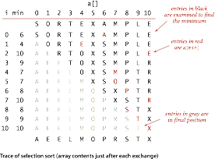
Selection sort: mathematical analysis
Proposition. Selection sort uses (N - 1) + (N − 2) + ... + 1 + 0 ~ N ² / 2 compares and N exchanges.
Running time insensitive to input. Quadratic time, even if input is sorted.
Data movement is minimal. Linear number of exchanges.
Notes:
intuition: trucks (or train cars) parked at waiting station, leave in order of weight -> expensive exchange, easy compare

Slide 35
Selection sort - Implementation
Selection sort in array
Selection sort in array of structs
Selection sort of bag items
Selection sort of array of pointers
Binary Search in sorted array

